Slide 1


SRI RAMAKRISHNA ENGINEERING COLLEGE
[Educational Service : SNR Sons Charitable Trust]
[Autonomous Institution, Accredited by NAAC with ‘A’ Grade]
[Approved by AICTE and Permanently Affiliated to Anna University, Chennai]
[ISO 9001:2015 Certified and all eligible programmes Accredited by NBA]
VATTAMALAIPALAYAM, N.G.G.O. COLONY POST, COIMBATORE – 641 022.
Department of Electronics and Communication Engineering
16EC258-MINIPROJECT II
No. of Credits : 2

Slide 2
SRI RAMAKRISHNA ENGINEERING COLLEGE
Class / Section / Semester | : | III ECE / B / VI
Batch | : | 2019-23
Project Review | : | IV
Title of the project | : | RETAIL DEMAND FORECASTING USING CNN-LSTM MODEL
Date | : | 30.05.2022
Project Guide | : | Mr. T. Rajasekar, AP/ECE
Team Members | : | 1.Karthik K (1902102) 2.Nithin Soundar S J (1902132) 3.Rithick Roshan R (1902156)

Slide 3
CHALLENGE STATEMENT
To forecast the demand of retail products in stores.
To minimize the replenishment between warehouses and stores.

Slide 4
CONCEPT / SCOPE OF SOLUTION
Planning to meet demand that’s lower than what actually needs to be met will leave you scrambling to catch up. Planning to meet demand that is higher than what actually materializes will result in overstaffing and excess inventory. This is bad for the customer and bad for the store’s operational metrics.
Demand forecasting in retail is the act of using data and insights to predict how much of a specific product or service customers will want to purchase during a defined time period. This method of predictive analytics helps retailers understand how much stock to have on hand at a given time.
It is based upon the real-time analysis of demand which was there in the past for that particular product or service in the market present today.

Slide 5
LITERATURE SURVEY /
BACKGROUND STUDY
PAPER | APPROACH | REMARKS
1.Hashini Warnakulasooriya, Janangi Senarathna et al. “Supermarket Retail – Based Demand and Price Prediction of Vegetables”. 20th International Conference on Advances in ICT for Emerging Regions (ICTer) Year: 2020 | Conference Paper | Publisher: IEEE | ARIMA- “autoregressive integrated moving average.” | This paper uses a vegetable tracking mechanism to improve transparency within the vegetable supply chain. This paper has forecasted the future price and demand of retail vegetables.

Slide 6
LITERATURE SURVEY /
BACKGROUND STUDY
PAPER | APPROACH | REMARKS
2. Keqiao Chen. “An Online Retail Prediction Model Based on AGA-LSTM Neural Network”. 2nd International Conference on Machine Learning, Big Data and Business Intelligence (MLBDBI)Year: 2020 | Conference Paper | Publisher: IEEE | LSTM neural network The adaptive genetic algorithm (AGA) | This paper proposes an online retail prediction model based on AGA-LSTM neural network.

Slide 7
LITERATURE SURVEY /
BACKGROUND STUDY
PAPER | APPROACH | REMARKS
3. Shaz Hoda, Amitoj Singh et al. “Consumer Demand Modeling During COVID-19 Pandemic”. IEEE International Conference on Bioinformatics and Biomedicine (BIBM) Year: 2020 | Conference Paper | Publisher: IEEE | Deep Learning based LSTM method. SARIMAX models -Seasonal Auto Regressive Integrated Moving Averages with Exogenous regressors. | The paper uses panel regression to understand the drivers of demand during the pandemic.

Slide 8
LITERATURE SURVEY /
BACKGROUND STUDY
PAPER | APPROACH | REMARKS
4. Fatima Zohra Benhamida, Ouahiba Kaddouri et al. “Stock&Buy: A New Demand Forecasting Tool For Inventory Control”. 5th International Conference on Smart and Sustainable Technologies (SpliTech) Year: 2020 | Conference Paper | Publisher: IEEE | Clustering-based approach (ClustAvg). Comb-TSB . | A clustering-based approach (ClustAvg) is proposed to forecast demand for new products which have very few or no sales history data.

Slide 9
EXISTING METHOD
The current methods of forecasting involves:
Conjoint Analysis
Conjoint analysis uses surveys to obtain consumer input about the most favorable attributes of their products. These surveys ask consumers how they would use and respond to certain product attributes.
Client Intent Surveys
With a buyer’s intentions survey, it asks what the consumer is planning on purchasing in the future. This technique is used to understand what motivates the customer to actually buy a product they are interested in.
Delphi Method
The Delphi method was developed with the assumption that forecasts from a group are generally more accurate than forecasts from individuals. As such, this method uses a panel of experts that provide their forecasts and justifications anonymously.
Advanced Planning and Scheduling (APS) Software

Slide 10
PROPOSED METHOD
The proposed method involves in the employment of predictive analysis.
Predictive analysis goes further than traditional demand forecasting by evaluating the reason why people buy. The process uses mathematical principles to predict consumer behavior by using current and historic data.
This model proposes a CNN-LSTM algorithm that combines the advantages of both Convolutional Neural Networks and Long-Short Term Memory cells to predict the demand for retail products within a stipulated time window to determine the optimal stock to be maintained at a retail outlet.
Adding convolutional layers to capture local, temporal patterns on top of LSTM layers can be immensely helpful.
The accuracy of CNN-LSTM model is greatly enhanced than the traditional LSTM model.
The demand of retail products is predicted using historical data of that particular retail outlet.

Slide 11
PROS AND CONS OF THE SOLUTION
Advantages of forecasting
One can gain valuable insight
One can learn from past mistakes
It can decrease costs
Disadvantages of forecasting
It can be time-consuming and resource-intensive

Slide 12
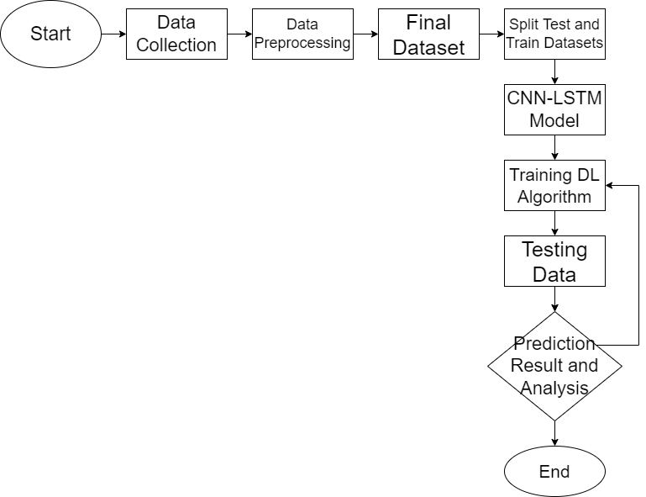
Block Diagram

Slide 13
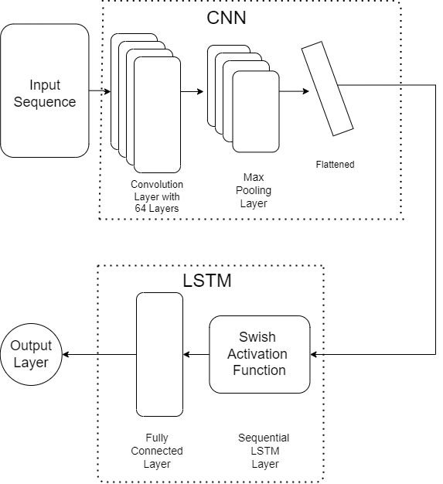
CNN-LSTM Model

Slide 14
TECHNOLOGY USED
Software:
Python
Google Colab
Deep Learning(Time Series)
Convolution Neural Networks- Long Short Term Memory Cells
Multi-Layer Perceptron Model

Slide 15
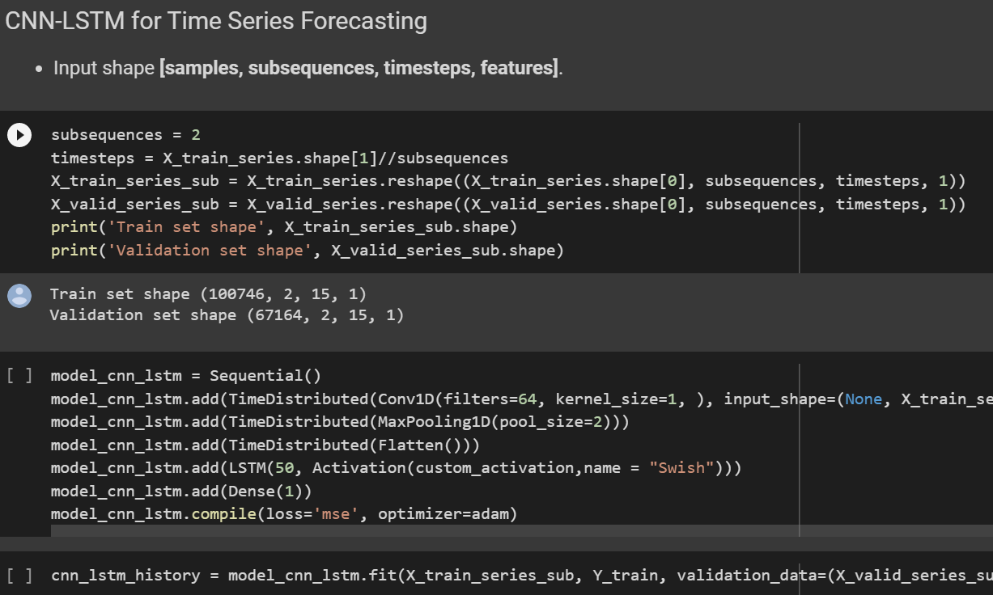
Algorithm

Slide 16
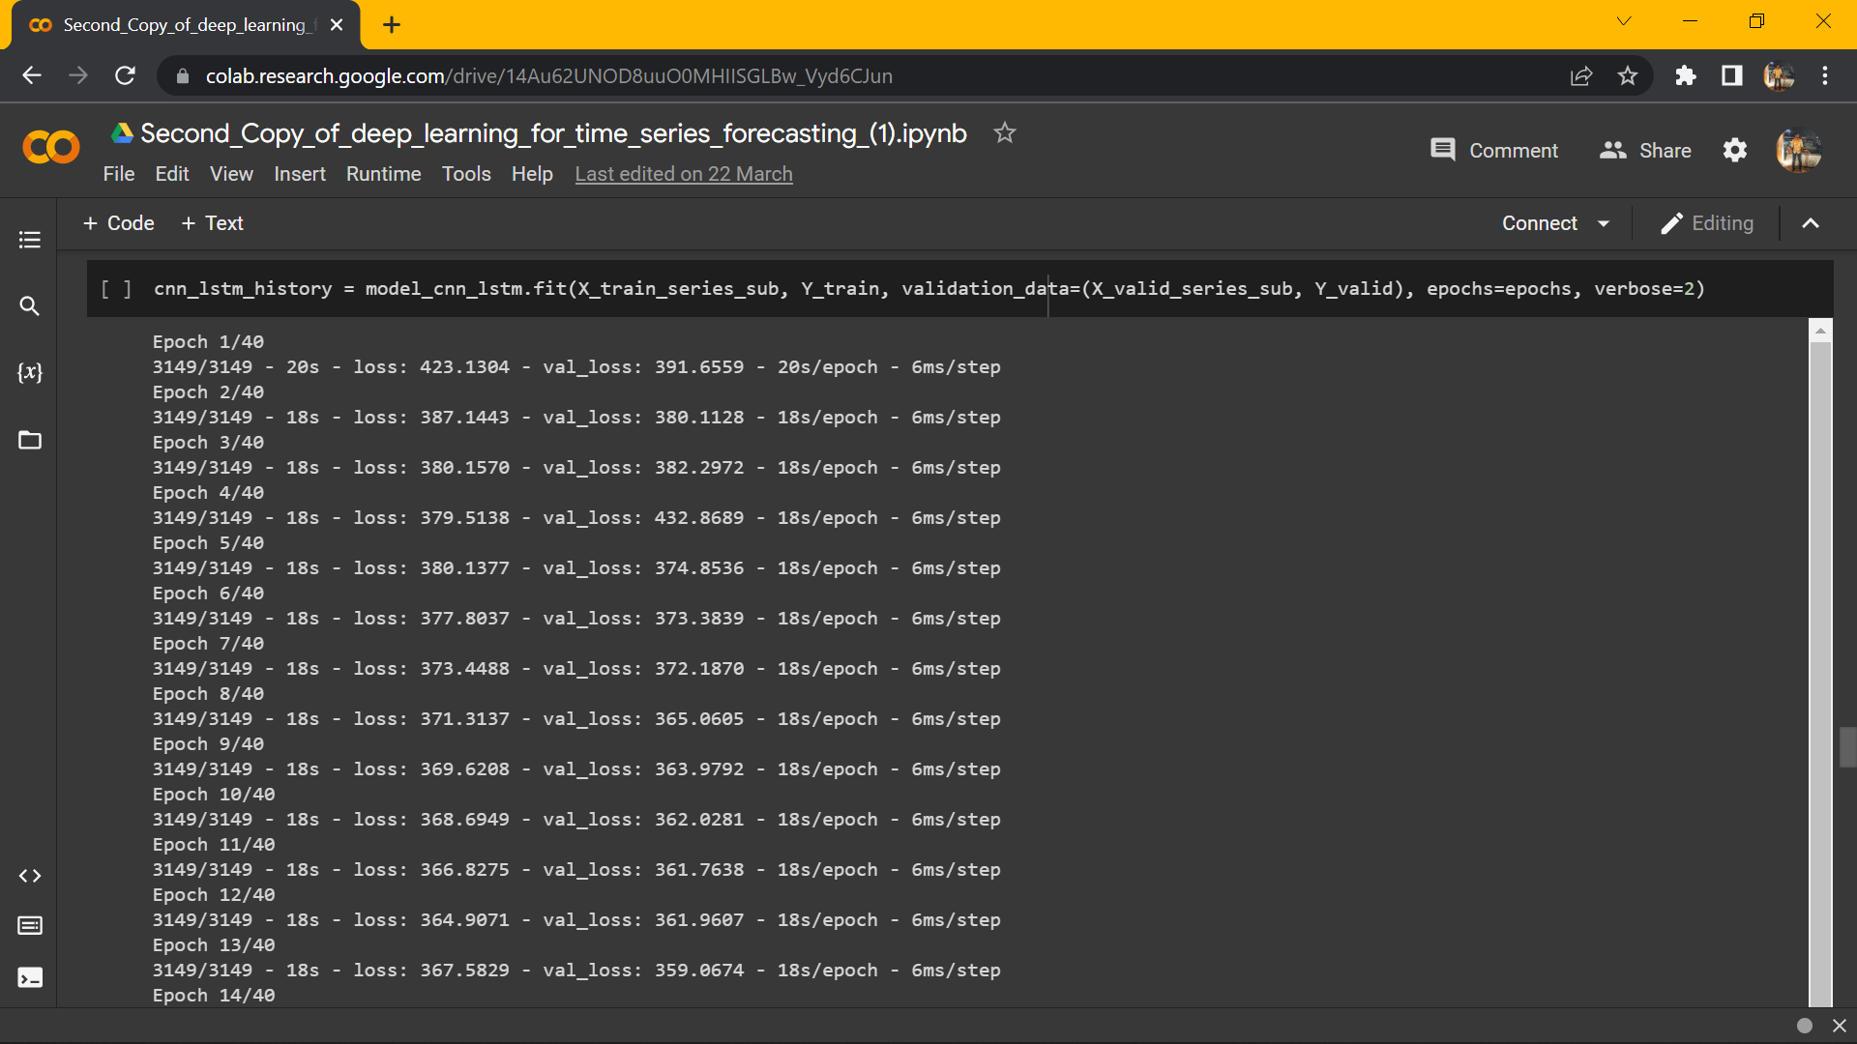
Algorithm

Slide 17
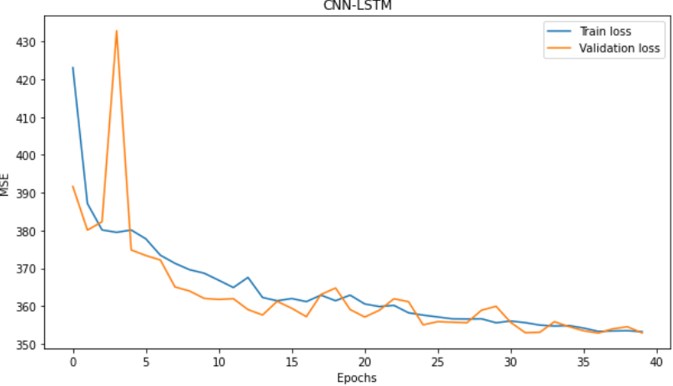
OUTPUT GRAPH

Slide 18
Comparison
S. No | Model | Swish |  | ReLU
 |  | Train RMSE | Validation RMSE | Train RMSE | Validation RMSE
1 | CNN- LSTM | 18.39 | 18.39 | 19.41 | 19.40
2 | Multilayer Perceptron | 18.31 | 18.40 | 18.31 | 18.44
3 | CNN | 18.45 | 18.58 | 18.56 | 18.66
4 | LSTM | 18.19 | 18.58 | 21.12 | 18.66
Comparison of Training RMSE and Validation RMSE with ReLU Activation Function and Swish Activation Function

Slide 19
Comparison
S. No | Model | Swish |  | ReLU
 |  | Train R² | Validation R² | Train R² | Validation R²
1 | CNN- LSTM | 0.696 | 0.698 | 0.623 | 0.620
2 | Multilayer Perceptron | 0.664 | 0.657 | 0.664 | 0.657
3 | CNN | 0.659 | 0.652 | 0.655 | 0.649
4 | LSTM | 0.668 | 0.652 | 0.553 | 0.649
Comparison of Training R² and Validation R² with ReLU Activation Function and Swish Activation Function

Slide 20
VALIDATION / TESTING / ANALYSIS
The model is evaluated using the following parameter
RMSE (Root Mean Square Error)
R² Value

Slide 21
RESULTS
The historic sales data set comprises more than 9,00,000 observations which are organized by date, store and item.
The dataset was taken from the public data set available at Kaggle under a project competition to predict future sales.
The columns of the dataset contain the date, store, item, sales.
The test dataset consists of 40% of the datasets and the training dataset consists of 60% of the datasets.
The proposed model was executed using an open-source platform called Google Colaboratory.
The CNN-LSTM model with swish activation function gives the least RMSE value

Slide 22
CONCLUSION
Predicting the demand for retail products is a challenging task as these depend on multiple parameters that form complex patterns.
Nonetheless, this model has obtained results regardless of these complex patterns. The model was fed data consisting of historic sales data which was pre-processed.
Various algorithms were compared and the best fit model was obtained.

Slide 23
FUTURE SCOPE
Demand Forecasting is based on scientific methods and proper judgment in order to correctly predict the future demand for a product or service.
It gathers information about various aspects of the market like future changes in the selling price, product designs, changes in competition, advertisement campaigns, the purchasing power of the consumers, employment opportunities, population, etc.
All the information gathered is scientifically analyzed so as to forecast the future demand for the product.
For future works, deep learning models which consider other parameters can be implemented.

Slide 24
REFERENCES
[1] Y. -F. Gao, Y. -S. Liang, Ying Liu, S. -B. Zhan and Z. -W. Ou, "A neural-network- based forecasting algorithm for retail industry," 2009 International Conference on Machine Learning and Cybernetics, 2009, pp. 919-924, doi: 10.1109/ICMLC.2009.5212392.J. Clerk Maxwell, A Treatise on Electricity and Magnetism, 3rd ed., vol. 2. Oxford: Clarendon, 1892, pp.68–73.
[2] Yuefang Gao, Yongsheng Liang, Fei Tang, Zhiwei Ou and Shaobin Zhan, "A demand forecasting system for retail industry based on neural network and VBA," 2010 Chinese Control and Decision Conference, 2010, pp. 3786-3789, doi: 10.1109/CCDC.2010.5498506.K. Elissa, “Title of paper if known,” unpublished.
[3] A. Palkar, M. Deshpande, S. Kalekar and S. Jaswal, "Demand Forecasting in Retail Industry for Liquor Consumption using LSTM," 2020 International Conference on Electronics and Sustainable Communication Systems (ICESC), 2020, pp. 521-525, doi: 10.1109/ICESC48915.2020.9155712.
[4] Yin Yafeng, Liu Yue, Gao Junjun and Tan Chongli, "A new fuzzy neural networks model for demand forecasting," 2008 IEEE International Conference on Automation and Logistics, 2008, pp. 372-376, doi: 10.1109/ICAL.2008.4636178

Slide 25
REFERENCES
[5] F. Z. Benhamida, O. Kaddouri, T. Ouhrouche, M. Benaichouche, D. Casado- Mansilla and D. López-de-Ipiña, "Stock&Buy: A New Demand Forecasting Tool for Inventory Control," 2020 5th International Conference on Smart and Sustainable Technologies (SpliTech), 2020, pp. 1-6, doi: 10.23919/SpliTech49282.2020.9243824.
[6] J. S, C. R, Y. Y M and S. D, "Automatic Warning System for Drivers using Deep Learning Algorithm," 2021 Second International Conference on Electronics and Sustainable Communication Systems (ICESC), 2021, pp. 1730-1737,
[7] K. Wanchoo, "Retail Demand Forecasting: a Comparison between Deep Neural Network and Gradient Boosting Method for Univariate Time Series," 2019 IEEE 5th International Conference for Convergence in Technology (I2CT), 2019, pp. 1-5, doi: 10.1109/I2CT45611.2019.9033651.

Slide 26
THANK YOU

